Slide 1
Comparison of PRNG
Thomas Kyte

Slide 2
Comparisons (using 4 sizes and seeds)
Time
Chi squared
Percent coverage

Slide 3
Linear congruential (p-values)
Linear congruential | seed
- | 11111111 | 26857536 | 39991234 | 57224956
100 | 0.99959 | 0.99959 | 0.99959 | 0.99959
1,000 | 2.79E-181 | 2.79E-181 | 2.79E-181 | 2.79E-181
10,000 | 0.0 | 0.0 | 0.0 | 0.0
10,000,000 | 0.0 | 0.0 | 0.0 | 0.0

Slide 4
Lagged Fibonacci (p-values)
lagged fibonacci | seed
- | 11111111 | 26857536 | 39991234 | 57224956
100 | 4.19E-38 | 0.35449 | 0.71981 | 0.47648
1,000 | 1.31E-181 | 1.65E-30 | 4.39E-21 | 2.61E-48
10,000 | 0.0 | 0.0 | 0.0 | 0.0
10,000,000 | 0.0 | 0.0 | 0.0 | 0.0

Slide 5
Middle square (p-values)
middle square | seed
- | 11111111 | 26857536 | 39991234 | 57224956
100 | 0.16117912 | 0.892820239 | 0.247178279 | 0.719808965
1,000 | 0.0 | 0.0 | 3.32E-35 | 0.0
10,000 | 0.0 | 0.0 | 0.0 | 0.0
10,000,000 | 0.0 | 0.0 | 0.0 | 0.0

Slide 6
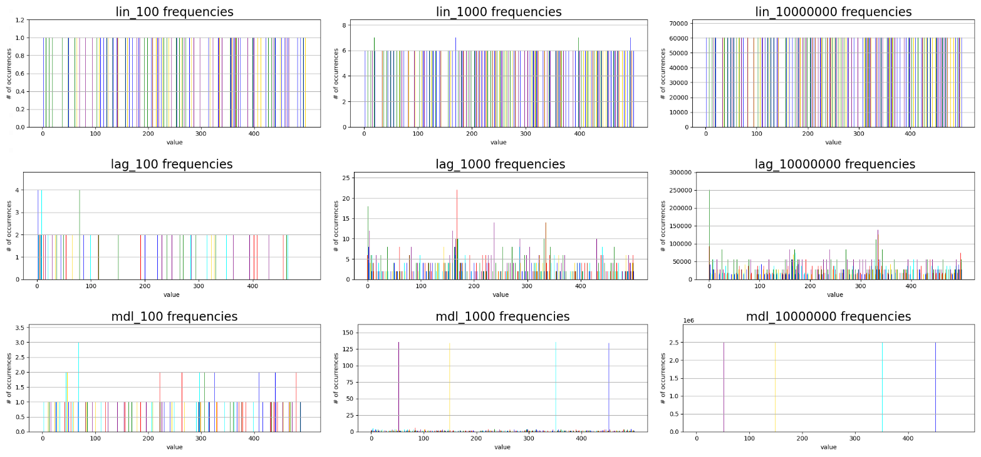
PRNG output: Seed 11111111
Lin coverage: 33.2%
Lag coverage: 61.2%
Mdl coverage: 59.2%

Slide 7
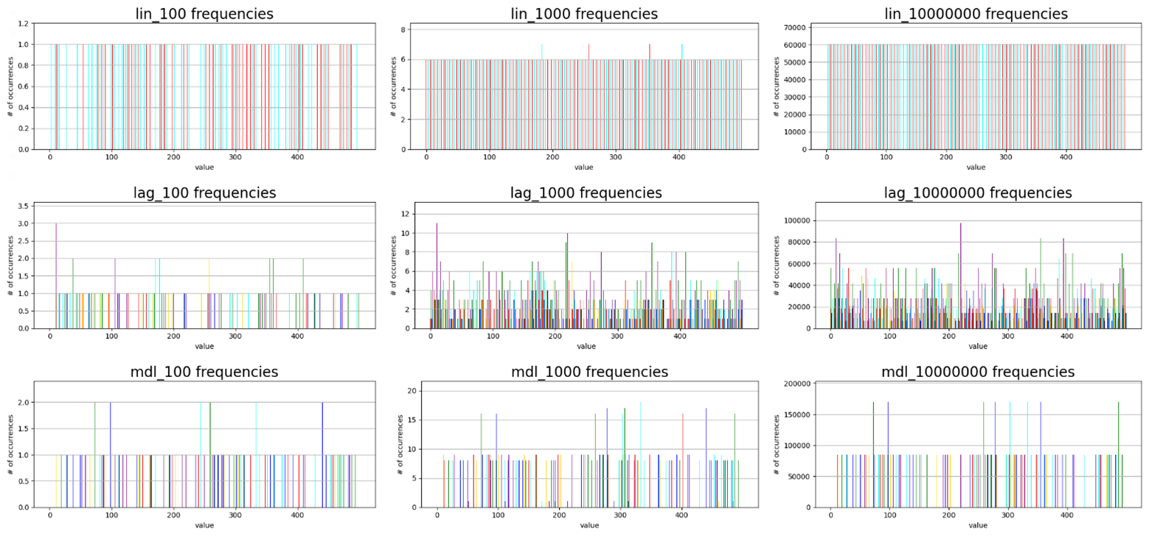
PRNG output: Seed 26857536
Lin coverage: 33.2%
Lag coverage: 83.4%
Mdl coverage: 23.6%

Slide 8
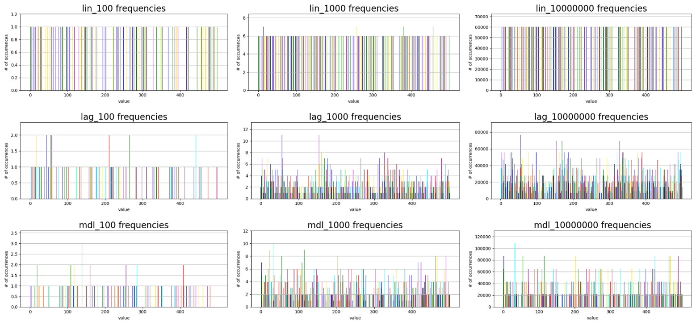
PRNG output: Seed 39991234
Lin coverage: 33.2%
Lag coverage: 84.6%
Mdl coverage: 66.0%

Slide 9
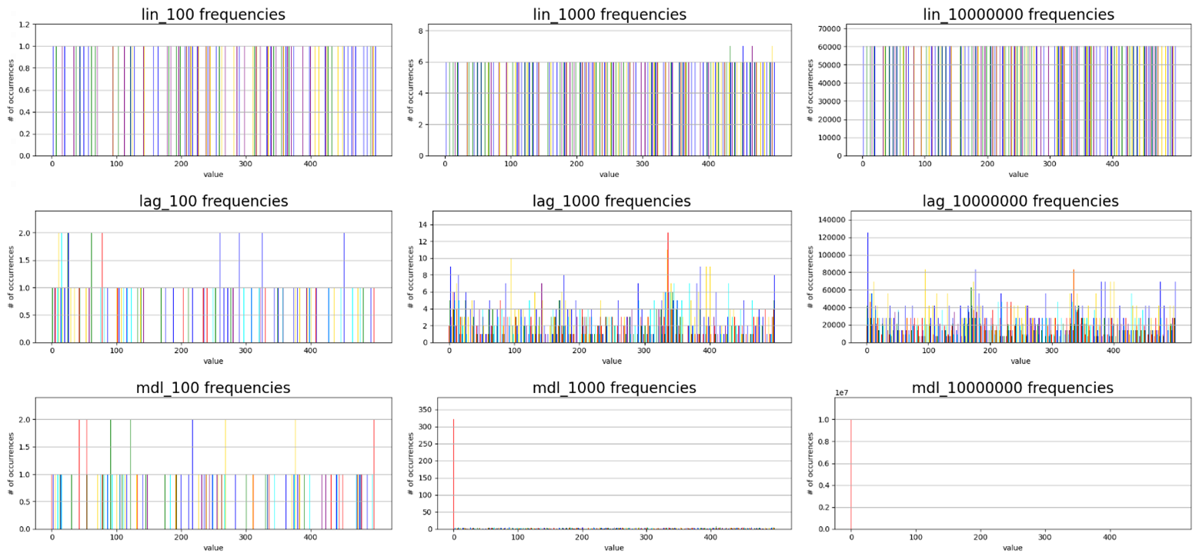
PRNG output: Seed 57224956
Lin coverage: 33.2%
Lag coverage: 78.6%
Mdl coverage: 73.8%

Slide 10
Average Times

Slide 11
Data analysis
linear congruential (lin)
Best used when only a few unique numbers are needed, fastest run time of all tested algorithms.
lagged Fibonacci (lag)
Best used when large quantities of random numbers are needed generated, runs faster than middle square method of generating pseudo random numbers.
Middle-square method (mdl)
Can be used to generate medium amounts of random numbers. However, this method is prone to entropy and even on good seeds produces a smaller range of numbers compared to the lagged Fibonacci method. No real advantages when compared to linear congruential and lagged Fibonacci generators.

